Slide 1

Department of Computer Engineering
Sequential Logic Design
1

Slide 2
Points covered
Department of Computer Engineering
Introduction
Flip flop
2

Slide 3
Department Vision & Mission
Department of Computer Engineering
Vision
Achieve academic excellence through education in computing, to create intellectual manpower to explore professional, higher educational and social opportunities.
Mission
To impart learning by educating students with conceptual knowledge and hands on practices using modern tools, FOSS technologies and competency skills there by igniting the young minds for innovative thinking, professional expertise and research.

Slide 4
Sequential Circuit
Department of Computer Engineering
A sequential circuit is one whose outputs depend not only on its current inputs, but also on the past sequence of inputs.
In other words, sequential circuits must be able to ”remember” (i.e., store) the past history of the inputs in order to produce the present output.
The information about the previous inputs history is called the state of the system.

Slide 5
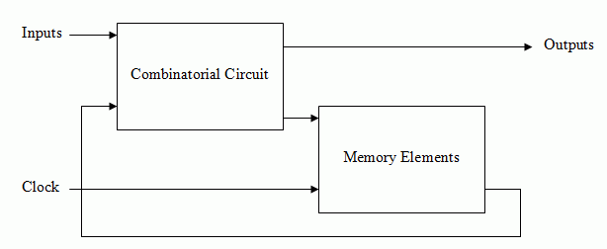
Sequential Circuit
Department of Computer Engineering

Slide 6
Department of Computer Engineering
Differences
Combinational circuits
Output depends on present input only
2. It does not have memory element
3. Clock input is not required
EX: Adders, Subtractors,
Code Convertors
Sequential circuits
Output depends on present inputs as well as previous inputs / Past outputs.
2. Memory element is necessary
3. Clock input is required
Ex: Flip flops, Shift Registers, Counters

Slide 7
Department of Computer Engineering
Flip-flop
Flip-flip is one bit memory cell.
A flip-flop is a circuit that has two stable states and can be used to store state information.

Slide 8
Department of Computer Engineering
1 Bit Memory Cell
Properties
The output Q and Q̅̅are always Complementary.
The Circuit has two stable State.(i.e. Q=1 Set State and Q=0 Reset State).
The Circuit continues to remain in the same state referred as Memory.
The information is latched or locked in this circuit ,so it is also referred as Latch.
0
G1
1
A₁
Q
1
G2
0
A₂
Q
Cross Couple Inverters as Memory Element

Slide 9
Latches & Flip flops
Department of Computer Engineering
The two most popular varieties of storage cells used to build sequential circuits are: latches and flip-flops.
Latch: level sensitive storage element
Flip-Flop: edge triggered storage element
SR latches.
D, JK, SR & T flip flops.
The difference between a latch and a flip-flop is that a latch is level-triggered (outputs can change as soon as the inputs changes)
Flip-Flop is edge triggered (only changes state when a control signal goes from high to low or low to high).

Slide 10
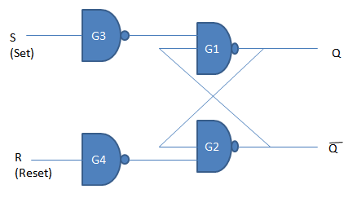
Department of Computer Engineering
1 Bit Memory Cell with input (SR FF)
IF S=R=0 Circuit will be same state i.e. No Change.
IF S=1 & R=0 then Q=1
IF S=0 & R=1 then Q=0
IF S=R=1 , then both the outputs Q and Q̅ will try to become 1 which is not allowed and therefore this input condition is prohibited
(Race Condition).

Slide 11
Department of Computer Engineering
1 Bit Memory Cell with input (SR FF)
IF S=R=0 Circuit will be same state i.e. No Change.
0
1
1
0
0
1
0
1
0
1
0
1
0
0
1
1

Slide 12
Department of Computer Engineering
1 Bit Memory Cell with input (SR FF)
1
0
IF S=1 & R=0 then Q=1
1
1
0
0
1

Slide 13
Department of Computer Engineering
1 Bit Memory Cell with input (SR FF)
0
1
IF S=0 & R=1 then Q=0
0
1
0
1
1
0

Slide 14
Department of Computer Engineering
1 Bit Memory Cell with input (SR FF)
1
0
IF S=R=1 , then both the outputs Q and Q̅ will try to become 1 which is not allowed and therefore this input condition is prohibited
(Race Condition).
1
1
1
1
1
0

Slide 15
1 Bit Memory Cell with input (SR FF)
IF S=R=0 Circuit will be same state i.e. No Change.
IF S=1 & R=0 then Q=1
IF S=0 & R=1 then Q=0
IF S=R=1 , then both the outputs Q and Q̅ will try to become 1 which is not allowed and therefore this input condition is prohibited
(Race Condition).

Slide 16
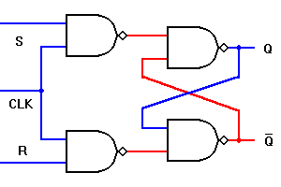
A Clocked S-R Flip Flop
Truth Table:- shows operation of circuit in tabular format
Input | Input | Output
Sn | Rn | Qn+1
0 | 0 | Qn
1 | 0 | 1
0 | 1 | 0
1 | 1 | ?

Slide 17
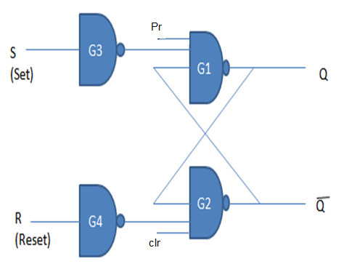
S-R Flip Flop with Preset and Clr
1
1
1
0
0
1
clk
1
0
1
0
1

Slide 18
0
1
1
1
1
0
1
1
0
1
0
0
clk
clk
1
0
1
1
0
1
0
0
1
0
Clk | Inputs Cr Pr |  | Output | Operation performed
1 | 1 | 1 | SR- Table | Normal Flip-flop
0 | 1 | 0 | 1 | Preset
0 | 0 | 1 | 0 | Clr

Slide 19
Department of Computer Engineering
Thank you

